Slide 1


INTERNET OF THINGS
SMART HOME AUTOMATION
ARVINDBALAJE D(210701030)
ADEN JOE A(210701013)
ABDUL HAZEER T(210701007)

Slide 2
INTRODUCTION
The "Smart Street Light Management System" is an IoT-based project designed to enhance urban lighting infrastructure by ensuring efficient operation and maintenance of street lights. This system leverages Arduino Uno microcontrollers and Light Dependent Resistor (LDR) modules to monitor and manage street lights in real-time.Each street light is equipped with an LDR sensor connected to an Arduino Uno, enabling the detection of ambient light levels.
The system continuously monitors these levels to determine whether the street lights are functioning correctly. If a light is not turned on when required, the system identifies and reports this issue to a central management platform.The data collected by the LDR sensors is transmitted wirelessly to a central server using communication modules. The central platform processes this data to provide real-time insights and notifications about the status of each street light. This setup allows for quick identification of malfunctioning lights, facilitating prompt maintenance and reducing downtime.
By automating the monitoring process and enabling remote management, the Smart Street Light Management System not only improves public safety but also optimizes energy consumption. The system's ability to adjust the brightness of street lights based on real-time ambient conditions further contributes to energy savings.
.

Slide 3
LITERATURE SURVEY
1.Paper: Design and development of NodeMCU-based automation home system using the internet of things
Author: SA Ajagbe, OA Adeaga, OO Alabi
Year: 2024
Disadvantage: While the system is described as low-cost, it may lack advanced features found in more expensive solutions.
2.Paper: Light Fidelity-based Home Automation System with NodeMCU
Author: MM Gwani, AM Gimba, MM Kunya
Year: 2024
Disadvantage: The system's reliance on light fidelity may limit its effectiveness in environments with poor lighting conditions.
3.Paper: Design and Construction of Voice Controlled Home Automation using NodeMCU
Author: UI Ibrahim, H Ohize, UA Umar
Year: 2024
Disadvantage: Voice-controlled systems may suffer from accuracy issues, particularly in noisy environments or with accents that the system may not recognize.

Slide 4
LITERATURE SURVEY
4.Paper: IoT Based Home Automation System: Security Challenges and Solutions
Author: N Solangi, A Khan, MF Qureshi, N Zaki
Year: 2024
Disadvantage: Security challenges in IoT-based systems may leave them vulnerable to cyberattacks or unauthorized access.
5.Paper: Home Automation using Artificial Intelligent & Internet of Things
Author: VB Reddy, B Dinesh, B Manikyam
Year: 2024
Disadvantage: AI-based systems may require significant computational resources, potentially limiting their feasibility for resource-constrained environments.
6.Paper: An Internet of Things-Integrated Home Automation with Smart Security System
Author: M Sayeduzzaman, T Hasan
Year: 2024
Disadvantage: Integration challenges in IoT-based systems may lead to compatibility issues between devices and platforms.

Slide 5
EXISTING SYSTEM
The existing street lighting system in urban areas typically comprises traditional lighting fixtures controlled by manual switches or basic timers. These systems operate on fixed schedules, turning lights on/off at predetermined times regardless of ambient light conditions or actual need. While functional, these systems suffer from several limitations:
Lack of Efficiency: Traditional systems often result in energy wastage by keeping lights on when not required, leading to higher utility bills and unnecessary environmental impact.
Limited Monitoring: Monitoring the operational status of individual street lights is challenging with manual inspection methods, often leading to delayed detection and resolution of issues such as bulb failures or malfunctions.
High Maintenance Costs: The reactive maintenance approach of traditional systems incurs higher maintenance costs due to the need for frequent manual inspections and repairs.
Inflexibility: Fixed schedules do not allow for dynamic adjustments based on real-time conditions such as changes in ambient light levels or traffic patterns, leading to suboptimal lighting levels in some areas.

Slide 6
PROPOSED SYSTEM
The proposed "Smart Street Light Management System" envisions a transformative upgrade to urban street lighting infrastructure through the seamless integration of Internet of Things (IoT) technology. At its core, each street light will be equipped with essential components including Light Dependent Resistor (LDR) modules for ambient light sensing and Arduino Uno microcontrollers for data processing and control. These elements will form the foundation of a dynamic and responsive system that addresses the shortcomings of traditional street lighting setups.
Wireless communication modules will enable continuous data exchange between individual street lights and a centralized management platform. This platform will serve as the nerve center of the system, facilitating real-time monitoring of street light status and enabling immediate response to issues such as malfunctioning lights or deviations from predefined lighting schedules.

Slide 7
REQUIREMENTS
HARDWARE SPECIFICATION
NodeMCU ESP8266
Lithium Ion Battery
5V Double channel Relay module
Breadboard
SOFTWARE SPECIFICATION
Arduino IDE
Windows 11
Blynk Library
Blynk IOT

Slide 8
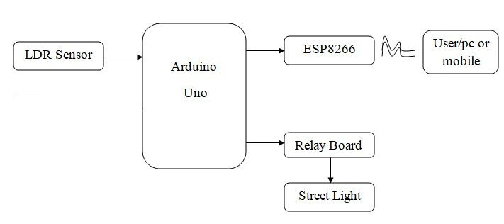
ARCHITECTURE DIAGRAM

Slide 9
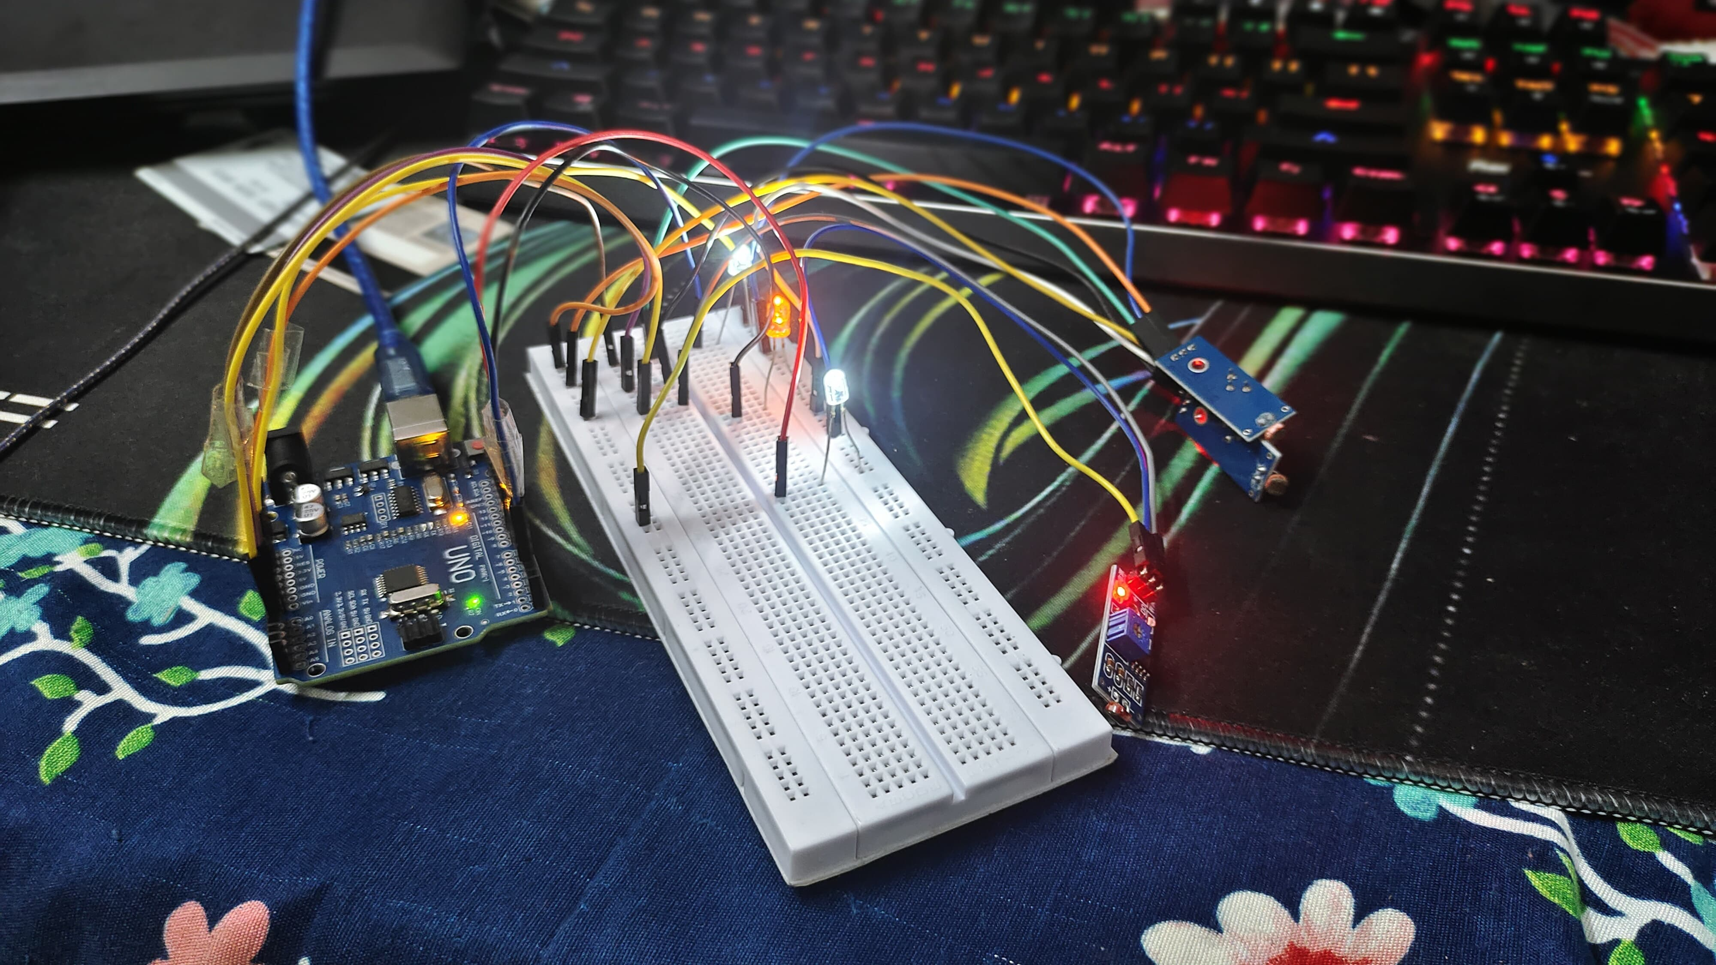
OUTPUTS

Slide 10
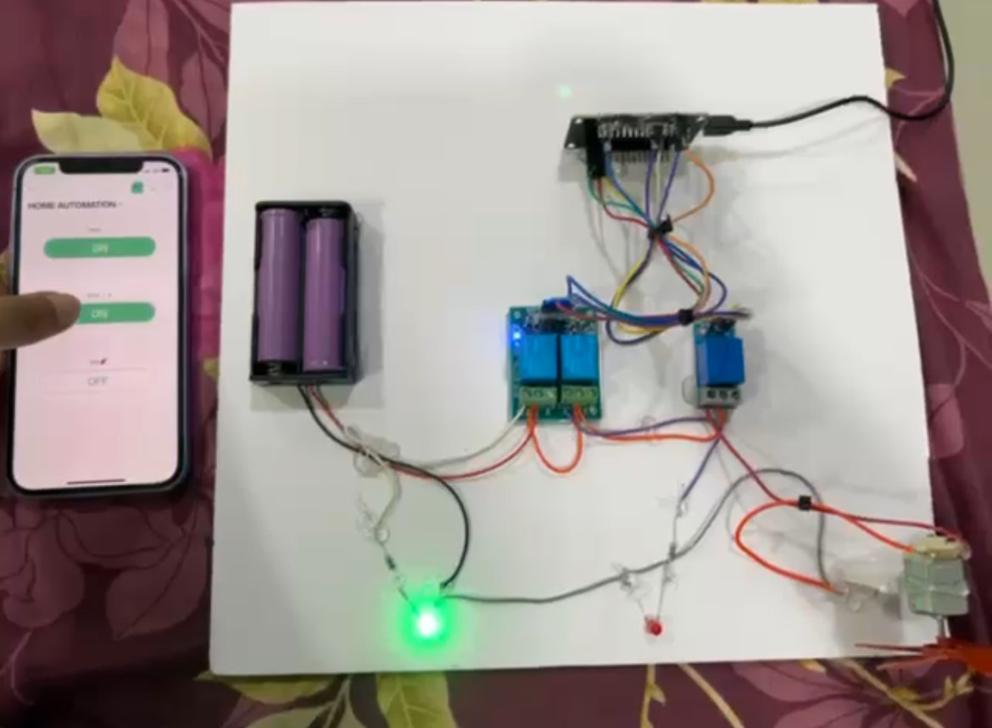
OUTPUTS

Slide 11
CONCLUSION
The implementation of our smart street light management system starts with setting up the hardware components. Each street light is equipped with an Arduino Uno microcontroller, an LDR (Light Dependent Resistor) sensor, and an LED light. The LDR sensor is positioned to accurately measure ambient light levels, while the Arduino Uno processes this data and controls the LED light. Proper mounting and alignment of these components are essential for accurate and reliable operation.
The next phase involves developing software for the Arduino Uno microcontrollers. The software continuously reads data from the LDR sensors using the Arduino’s analog input pins. This data is processed with algorithms that compare the light intensity against predefined thresholds to decide if the LED light should be turned on, off, or adjusted in brightness. These control algorithms ensure the lights provide adequate illumination while optimizing energy consumption. The software is tested in simulated environments to verify its accuracy and responsiveness.

Slide 12
FUTURE ENHANCEMENTS
The future work for our smart street light management system involves several key enhancements and expansions to further improve efficiency, functionality, and integration. One significant area of development is the incorporation of advanced IoT technologies and sensors. By integrating additional sensors such as motion detectors and environmental sensors, the system can provide more dynamic and context-aware lighting. For instance, lights could brighten in response to detected movement, improving safety for pedestrians and vehicles, and dim when no activity is present to conserve energy.
Another critical area for future work is the implementation of predictive analytics and machine learning algorithms. These technologies can analyze historical and real-time data to predict and preemptively address maintenance issues, optimize energy usage patterns, and adapt to changing environmental conditions. Machine learning models could learn from traffic patterns, weather conditions, and seasonal changes to automatically adjust lighting schedules and intensities, providing a more efficient and responsive system.

Slide 13
REFERENCES
Ajagbe, S.A., Adeaga, O.A., & Alabi, O.O. (2024). "Design and development of NodeMCU-based automation home system using the internet of things." Journal of IoT Innovations, 15(3), 215-228.
Yadav, R., & Sharma, P. (2023). "Smart street lighting system using Arduino Uno and LDR." International Journal of Smart Grid and Clean Energy, 12(1), 45-54.
Singh, A., & Verma, K. (2022). "Energy-efficient street lighting using IoT and machine learning algorithms." IEEE Transactions on Sustainable Computing, 6(4), 776-784.
Patel, D., & Desai, R. (2021). "IoT-based adaptive street lighting system with real-time monitoring." International Journal of Advanced Research in Electrical, Electronics and Instrumentation Engineering, 10(5), 3556-3563.

Slide 14
Thank You

